Slide 1


Tolulope ERIBAKE
14/01/2025

Slide 2

Outline
Executive Summary
Introduction
Methodology
Results
Conclusion
Appendix

Slide 3
Executive Summary
In this project, data was collected from SpaceX’s API and cleaned, cross referenced and validated with similar data web-scraped from Wikipedia’s snapshot at a date of interest in the past to ensure data consistency. EDA is performed in SQL and using matplotlib visualizations. Dashboard is built using Plotly Dash. 4 binary classification models were then built, evaluated, fine-tuned and tested for accuracy in predicting rocket launch outcomes.
Predictive models yielded 83.33% accuracy which can still be improved upon in further work.

Slide 4
Introduction
Project Background and Context
SpaceX’s annoucement of more than 60% cost saving on it’s Falcon 9 rocket in comparison to other providers’, hinged on its ability to reuse the first stage of the rocket which depends on successful landing after launch.
Problems We Aim to Solve
- Collect and Prepare Data
Collect, clean and prepare past Falcon 9 launches data
- Predict the Likelihood of Successful Landing
Predict the outcome of Falcon 9’s first stage using ML

Slide 5

Section 1

Slide 6
Methodology
Executive Summary
Data collection methodology
Collected data by connecting to SpaceX’s API and scraping Wikipedia
Perform data wrangling
Missing values were replaced, categorical features were one-hot-encoded
Perform exploratory data analysis (EDA) using visualization and SQL
Perform interactive visual analytics using Folium and Plotly Dash
Perform predictive analysis using classification models
Leveraged Scikit-Learn to build, tune, evaluate classification models

Slide 7
Data Collection
Data sets were collected by connecting to SpaceX’s API using Requests and Pandas, and webscraping Wikipedia using combination of Requests, BeautifulSoup and Pandas.
From the API, the get method loads content of URL to a response variable whose json format is then loaded into dataframe using Panda’s normalize_json method.
On the webscraping side, text format of response of requests.get() is parsed as HTML into BeautifulSoup creating a soup object from which all element type “table” is found using the BeautifulSoup object function find_all.

Slide 8
Data Collection – SpaceX API
response = request.get()
response.json()
pandas.json_normalize()
SpaceX REST API calls

Slide 9
Data Collection - Scraping
response = request.get()
BeautifulSoup(response.text)
pandas.read_html()
Web scraping process

Slide 10
Data Wrangling
Null values were checked. Null values in Payload Mass was replaced with the average value.
Categorical columns converted to one-hot-encoded columns using pandas’ get_dummies method.

Slide 11
EDA with Data Visualization
Charts plotted include:
FlightNumber vs PayloadMass
FlightNumber vs LaunchSite
Payload Mass and Launch Site
Success rate of each Orbit type
FlightNumber and Orbit type
Payload and Orbit type
Launch success yearly trend
All these enable relationships and trend be visualized

Slide 12
EDA with SQL
EDA done with SQL include:
5 records where launch sites begin with the string 'CCA'
Total payload mass carried by boosters launched by NASA (CRS)
Average payload mass carried by booster version F9 v1.1
Date first successful landing outcome in ground pad was achieved
Total number of successful and failure mission outcomes
Booster versions which have carried the maximum payload mass
Rank of count of landing outcomes between 2010-06-04 and 2017-03-20 in descending order

Slide 13
Build an Interactive Map with Folium
Interactive map created with Folium shows:
markers of launch sites with circle
launch points where success is recorded in green
launch points where failure is recorded in red
line indicating flight distance of nearest rail to launch site
line indicating flight distance of nearest road to launch site
line indicating flight distance of nearest city to launch site

Slide 14
Build a Dashboard with Plotly Dash
Plotly Dash Dashboard contains two charts:
Pie chart showing success rate of ALL sites or any selected site
Scatter plot showing relationship between outcome and Payload Mass colored by launch site
Slider to regulate maximum and minimum of payload
Option selection to select launch site of interest

Slide 15
Predictive Analysis (Classification)
Data was split into 80/20 train/test split with train_test_split
Models tried are:
Logistic Regression
S Vector Machines (SVM)
Decision Tree Classifier
K-Nearest Neighbour (KNN)
Best performing hyperparameters were selected using GridSearchCV with 10-fold cross-validation
Accuracy of models on test set is used to select best performing model

Slide 16
Results
Yearly average rocket launch success rate increase in over time.
Launch sites are cited in remote location having quite some distance from cities.
Predictive analysis yielded accuracy of 0.833 on 20% test data set

Slide 17

Section 2

Slide 18
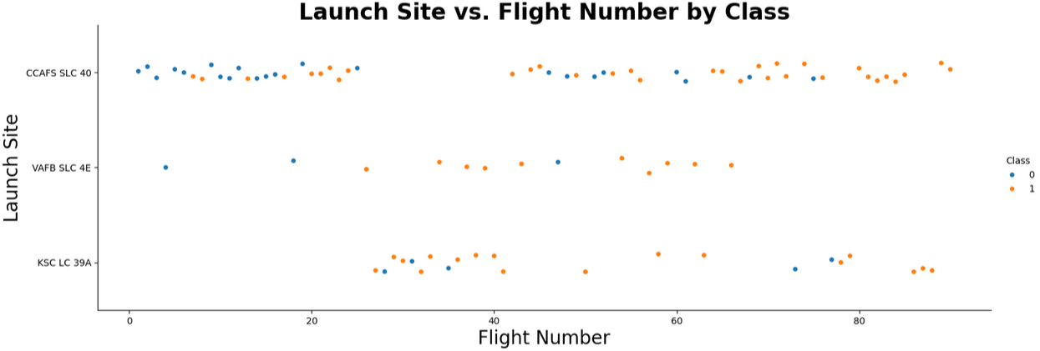
Flight Number vs. Launch Site
Scatter plot of Flight Number vs. Launch Site shows launches with lower flight numbers started in CCAFS SLC 40 with more failures. With increasing flight number is increase in successful launches.

Slide 19
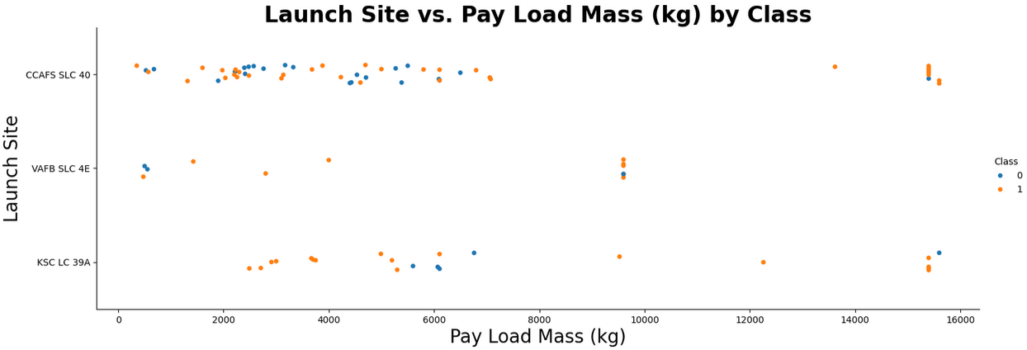
Payload vs. Launch Site
Scatter plot of Payload vs. Launch Site showing heavier payload mass support at KSC LC 39A and CCAFS SLC 40.

Slide 20
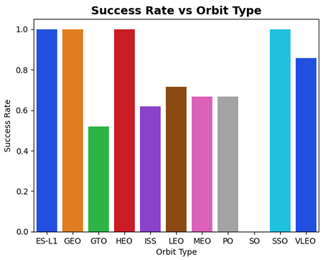
Success Rate vs. Orbit Type
Some Orbit types recorded 100% success. Success rates f others ranged from 50% to 90% except SO which has 0 success.

Slide 21
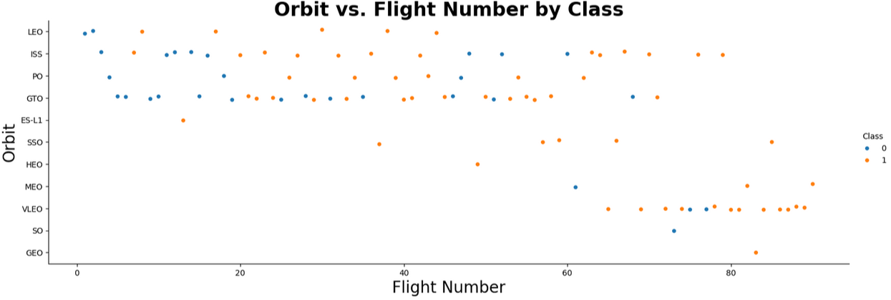
Flight Number vs. Orbit Type
Scatter plot of Flight number vs. Orbit type shows that some Orbit types only have one launch attempt including SO, which failed, GEO, ES-L1, and HEO, each of which succeeded. SSO is the only Orbit with more than one launch and perfect success.

Slide 22
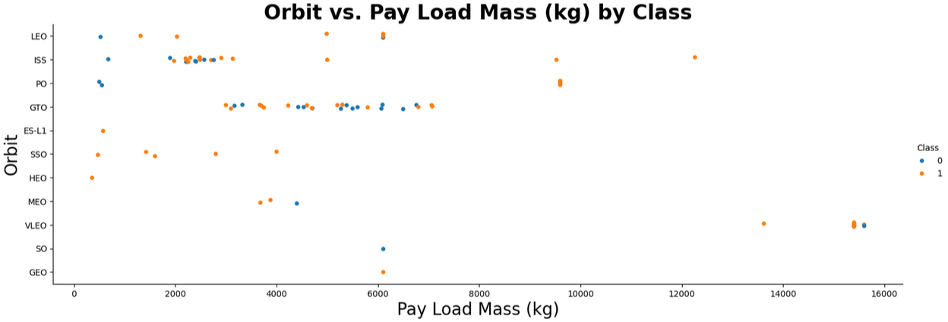
Payload vs. Orbit Type
Scatter plot of payload vs. orbit type clearly shows orbit types that recorded success despite heavier payload. We also see SSO launches all have payloads less than 4000kg.

Slide 23
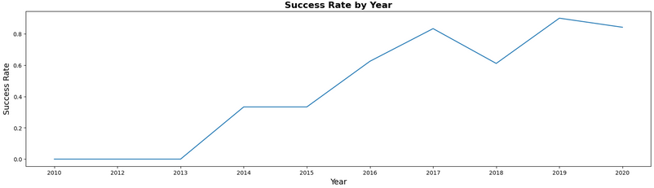
Launch Success Yearly Trend
Line chart of yearly average success rate indicating overall increase in success rate over time.

Slide 24
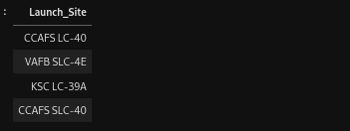
All Launch Site Names
Unique launch sites. 4 altogether.

Slide 25
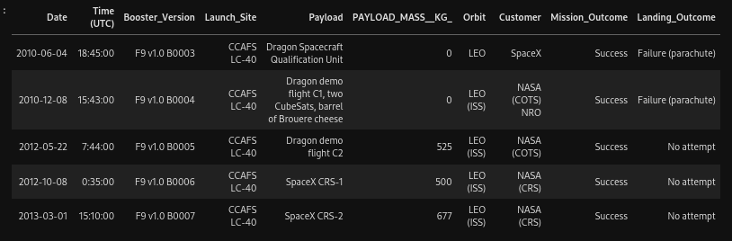
Launch Site Names Begin with 'CCA'
First 5 records where launch sites begin with `CCA`

Slide 26

Total Payload Mass
Total Payload Mass in kg done by NASA CRS

Slide 27

Average Payload Mass by F9 v1.1
Average Payload Mass done by Falcon 9 with Booster Version v1.1

Slide 28
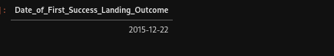
First Successful Ground Landing Date
Date first successful landing outcome was recorded

Slide 29
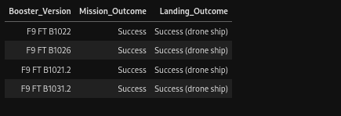
Successful Drone Ship Landing with Payload between 4000 and 6000
4 Successful mission outcomes and landing outcome in drone ship with payload mass between 4000kg and 6000kg

Slide 30

Total Number of Successful and Failure Mission Outcomes
Only one failed mission out of 101 outcomes.

Slide 31
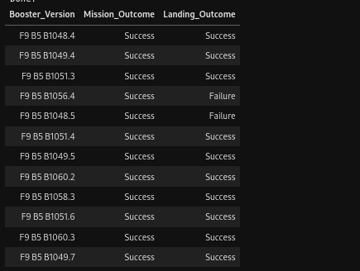
Boosters Carried Maximum Payload
Total of 12 Booster Versions with 2 having a Failure Landing Outcome.

Slide 32

2015 Launch Records
Months in 2015 failed landing outcomes occurred in drone ship with corresponding Booster Version and Launch Site.

Slide 33
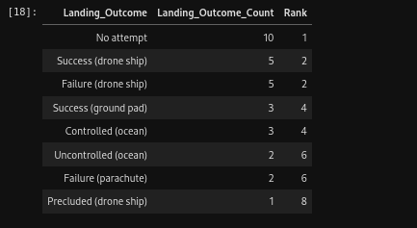
Rank Landing Outcomes Between 2010-06-04 and 2017-03-20

Slide 34

Section 3

Slide 35
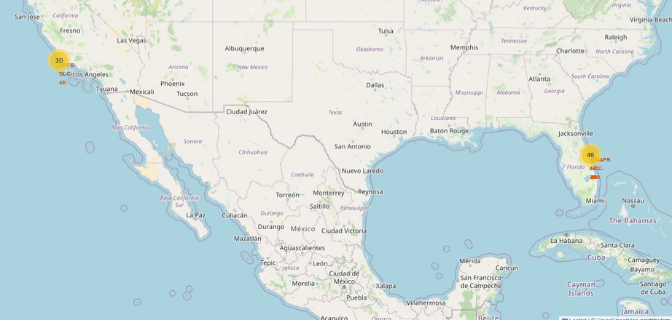
Map of Launch Sites
On the west is one site (VAFB SLC-4E) where 10 launch points are identified. On the east are three launch sites where a total of 46 launch points are identified.

Slide 36
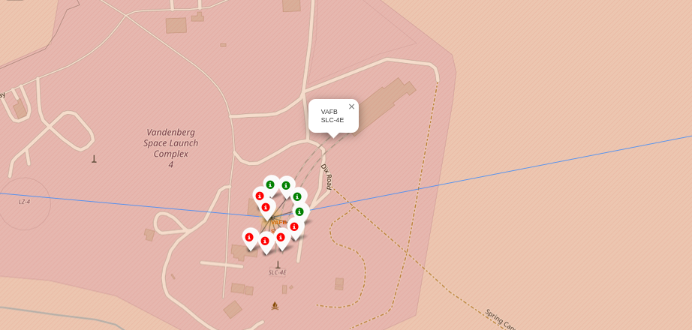
Successful and Failed Launches at VAFB SLC-4E
The Launch Site VAFB SLC-4E clearly shown as Vanderberg Space Launch Complex 4 show 6 failed and 4 successful launches.

Slide 37
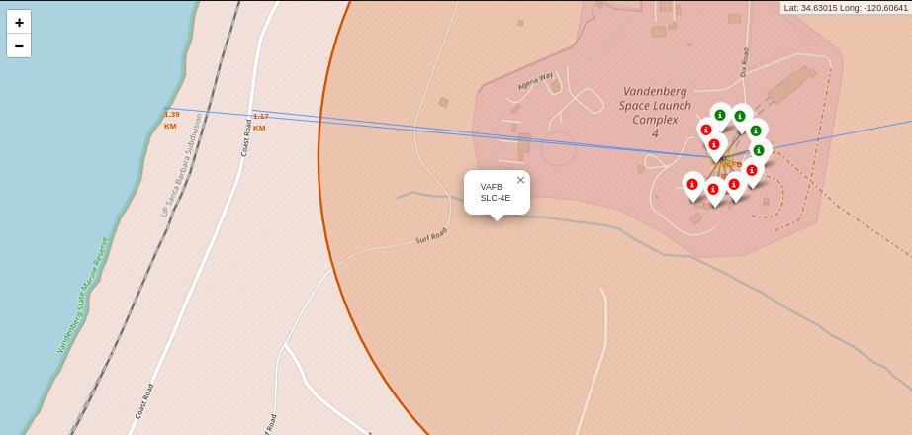
Launch Site to Shoreline, Rail and Road
Distance from center of Launch Site VAFB SLC-4E to shoreline is 1.39km while distance to Coast Road is 1.17km with rail line lying between both shoreline and road. The nearest city (not shown) is about 14km northeast of the launch site.

Slide 38

Section 4

Slide 39
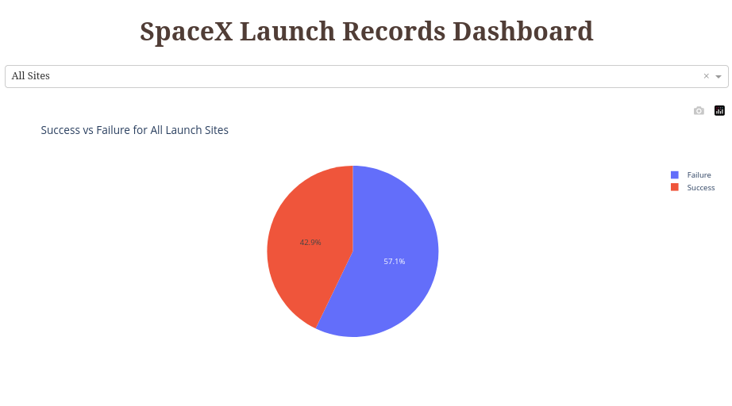
Success vs Failure for All Launch Sites

Slide 40
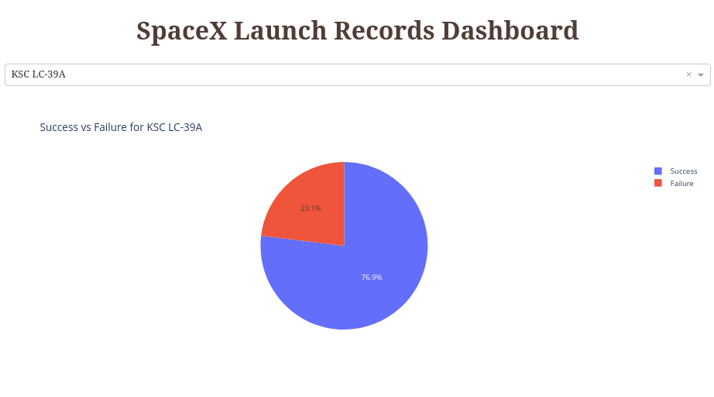
Success vs Failure for Site with Highest Success Rate

Slide 41
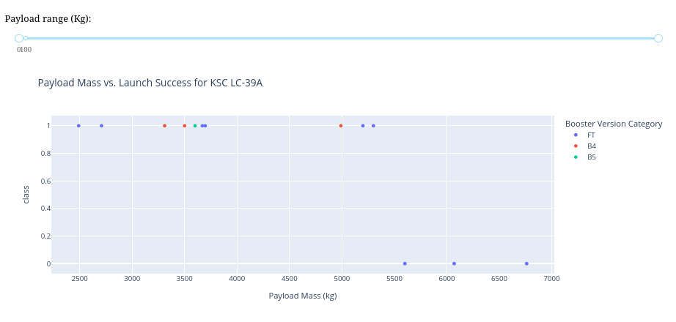
Payload vs Launch Success by Booster Version
Above clearly shows failure at Payload over 5500h for all launches at Launch Site KSC LC-39A with Booster Version FT

Slide 42

Section 5

Slide 43
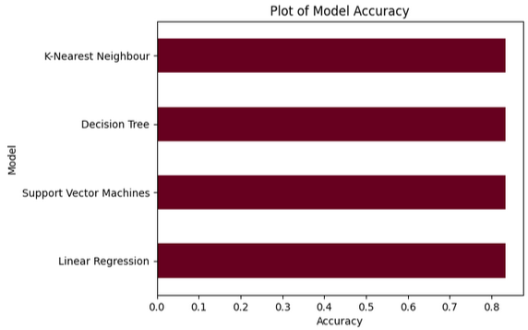
Classification Accuracy
All 4 models performed with similar accuracy of 83.33%
In which case, time and processor cost of execution will make more sense in choosing. SVM and KNN are costlier in those regards.

Slide 44
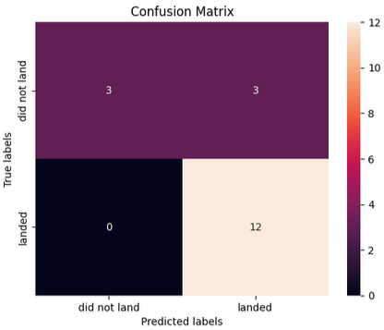
Confusion Matrix
All 4 models generated similar confusion matrix distribution implying similar precision and recall. In essence, similar F1 score.

Slide 45
Conclusions
Success rate of rocket launches has increased over the years.
There is more likelihood of successful rocket launch outcomes with lower payload mass.
It is possible to predict the outcome of rocket launch to a good level of accuracy.
Savings in rocket stage 1 reuse would save total cost of rocket launch.
Based on projected cost saving from re-usability, total cost of a launch can be better estimated.

Slide 46
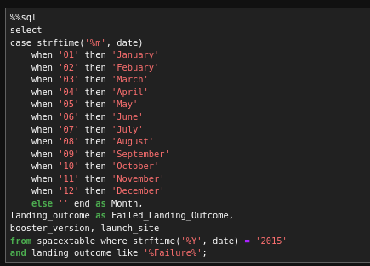
Appendix
Use of case when then end and strftime demonstrated

Slide 47


